Slide 1
EAGLE Pride
BEST Academy at
The Thomas W. Dortch Jr. Institute
Robert Williams, Principal

Slide 2
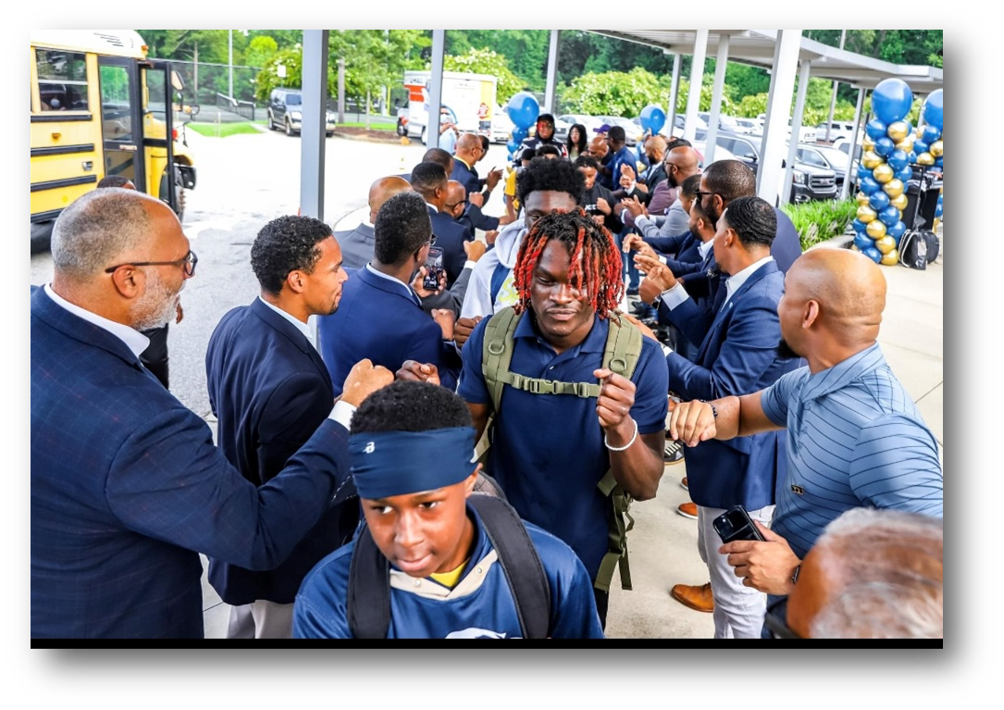
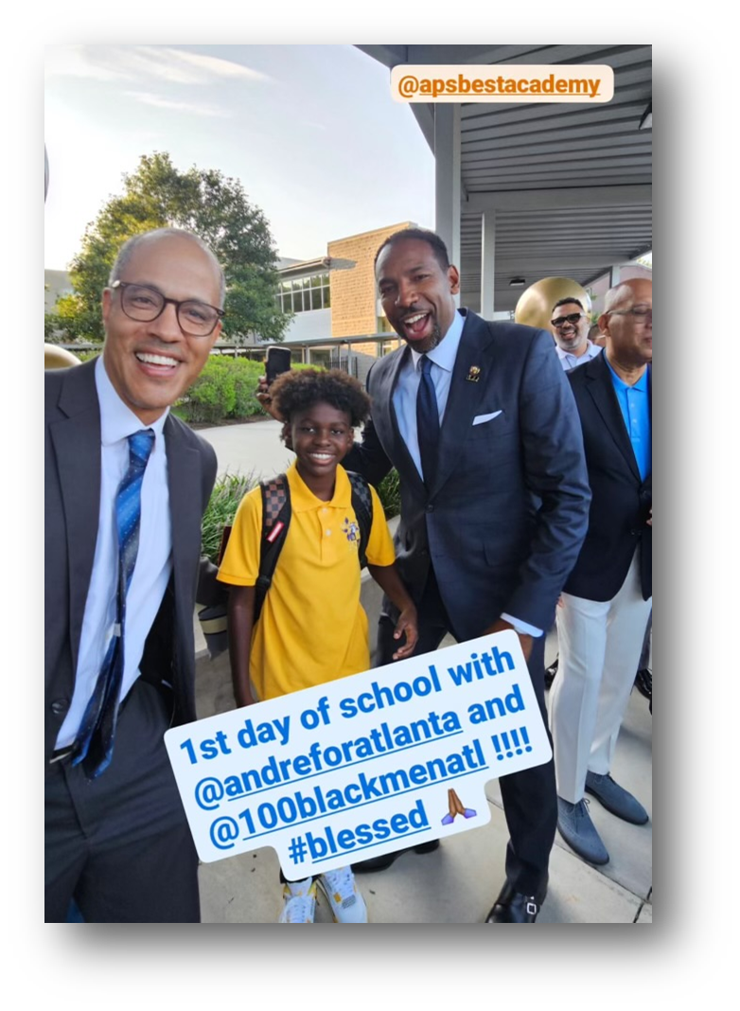
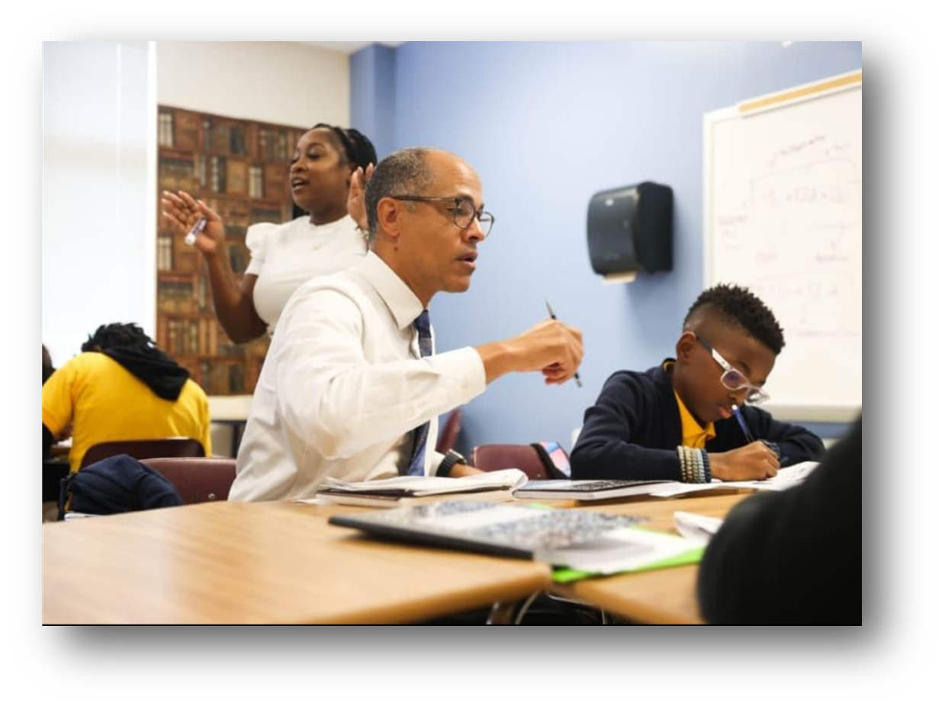
1st Day of School
The 100 Black Men of Atlanta and Emerging 100 welcome BEST Scholars back-to-school, with Seniors Kamden Smith and Derrell McBride leading the line.
Principal Robert Williams, Jahlil Muhammad, and Atlanta Mayor Andre Dickens standing together.
Principal Robert Williams actively engages in an instructional lesson on the first day of school.

Slide 3
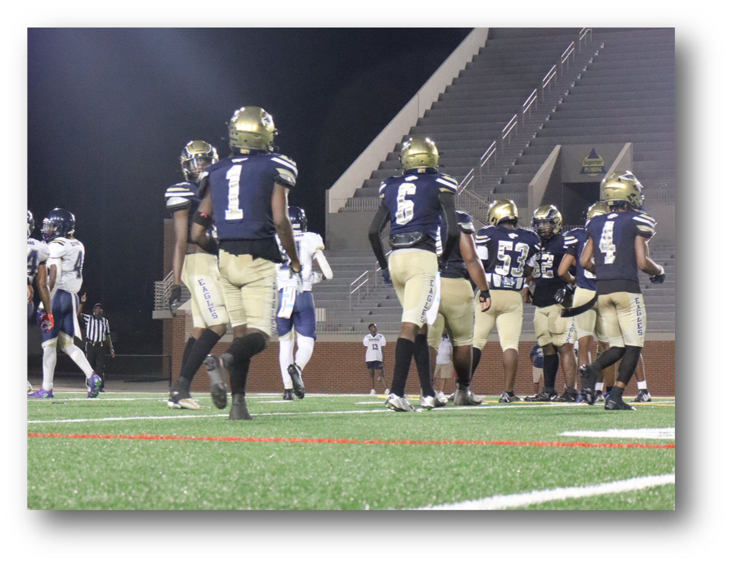
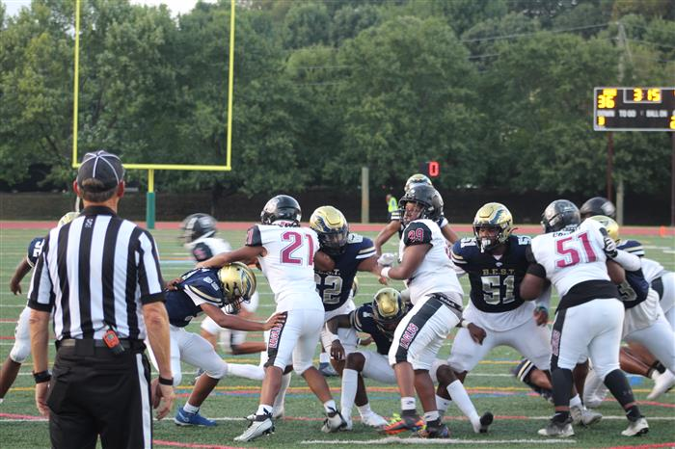
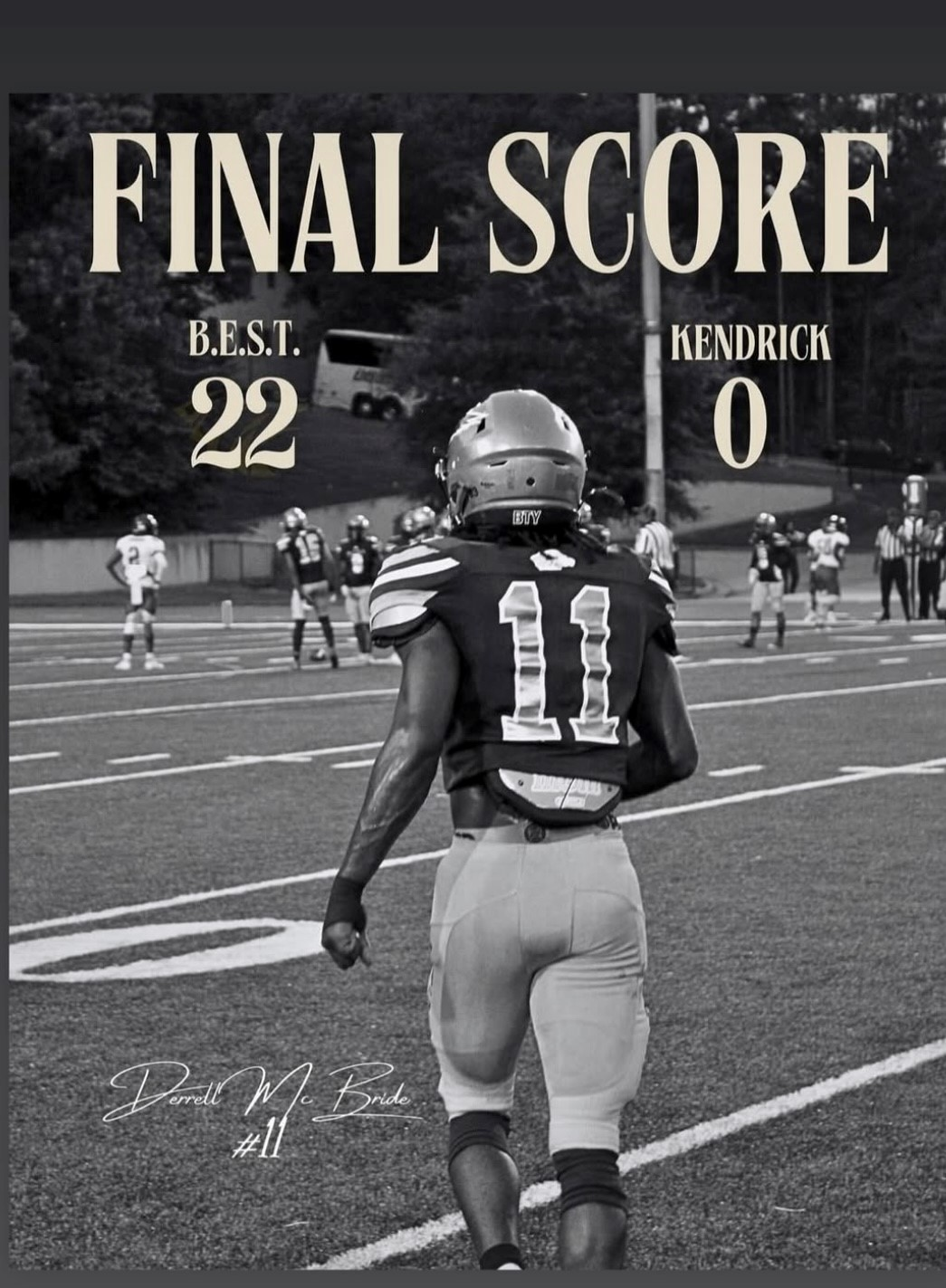
Varsity Football 2024
BEST Academy's Varsity Football Team kicks off the season by protecting the EAGLES Nest with a 49-0 win over Utopia Academy, Ellenwood, GA, on August 16th, and a 22-0 victory over Kendrick High School, Columbus, GA, on August 23rd. Go EAGLES!

Slide 4
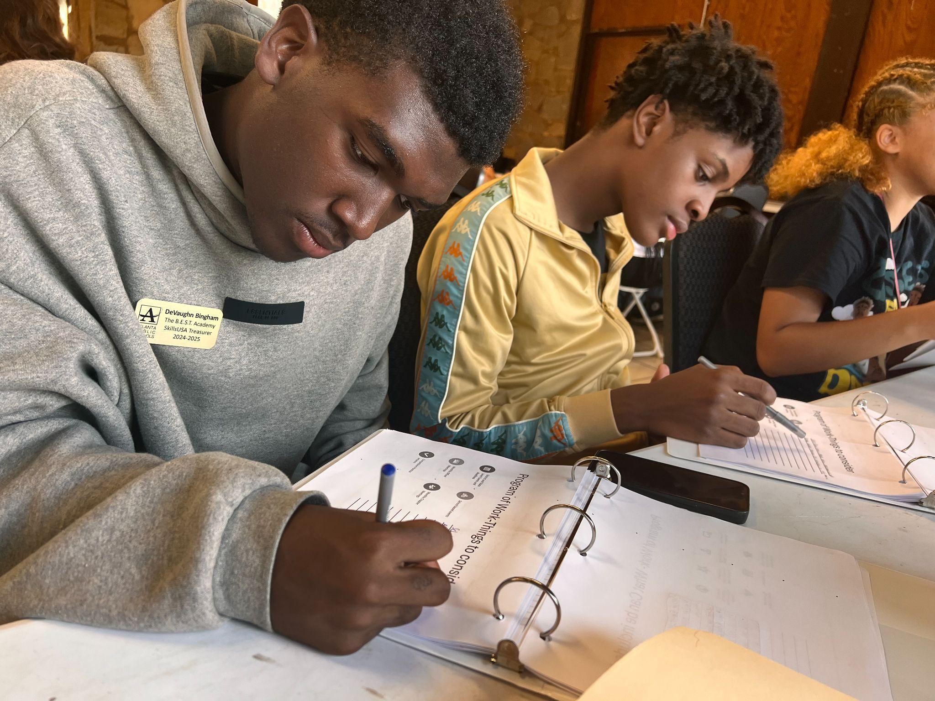
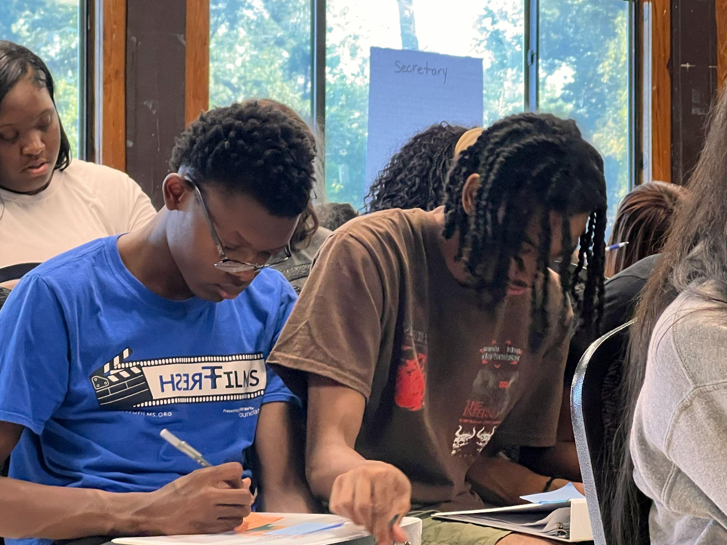
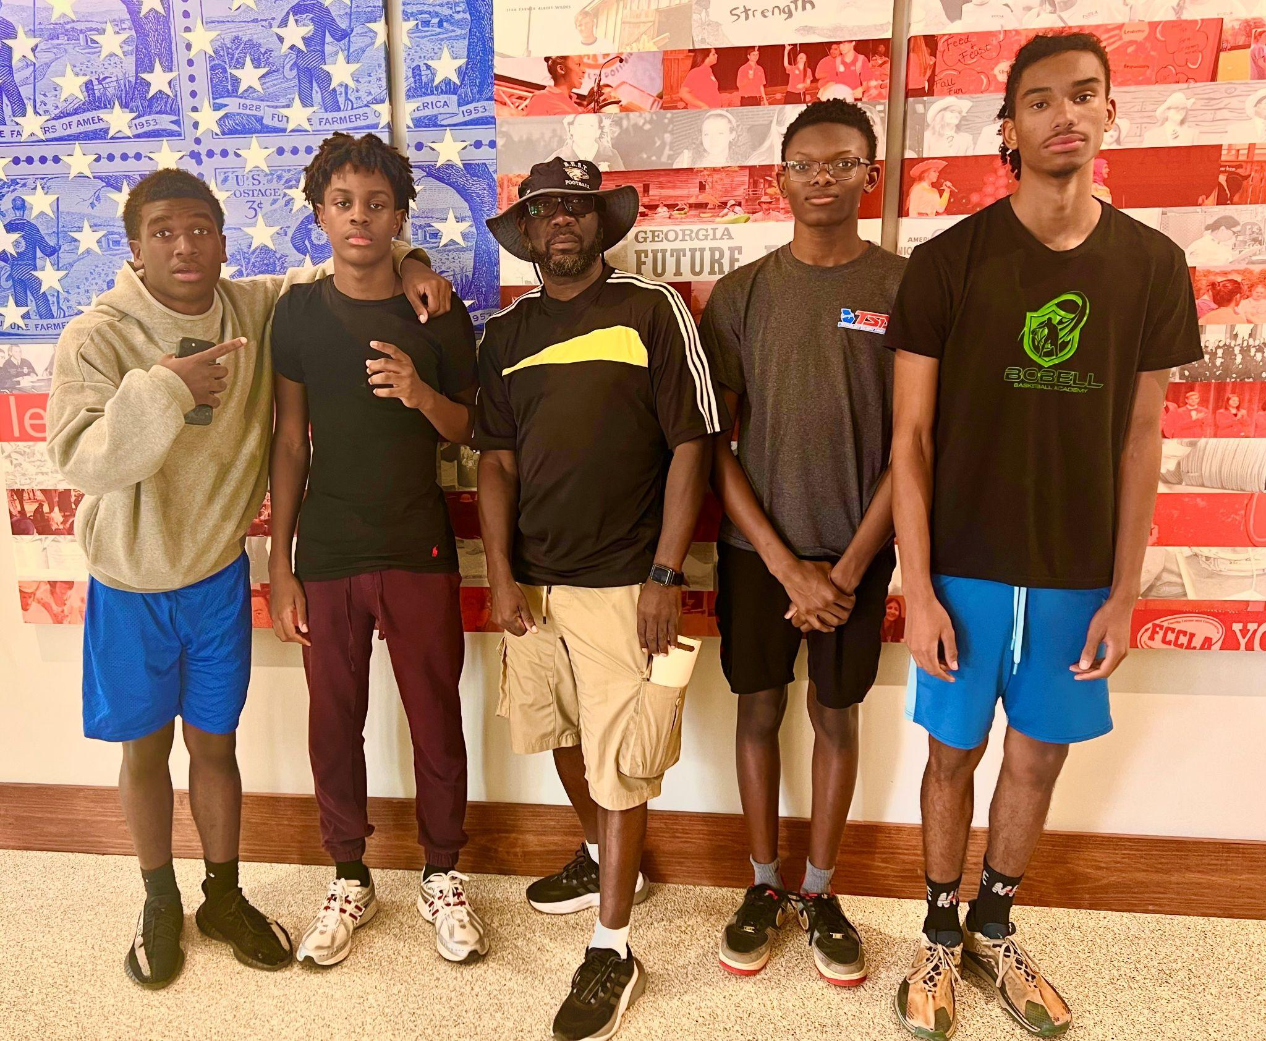
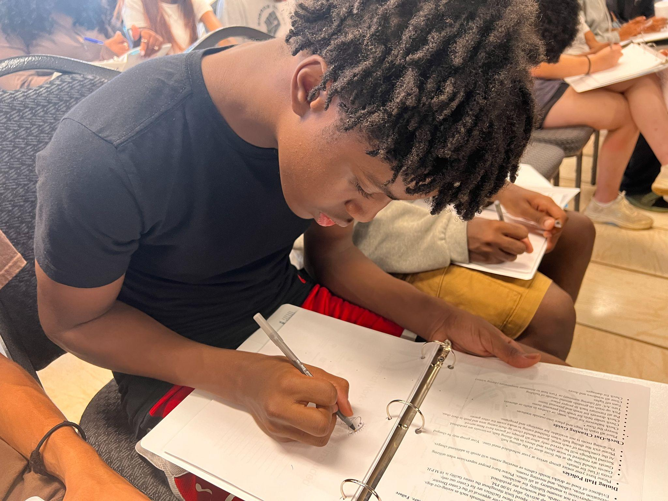
CTAE 2nd Annual Leadership Retreat
On August 27-28, BEST SkillsUSA - AVTF scholars attended the APS CTAE 2nd Annual Leadership Officers Retreat, participating in leadership and team-building activities at the Georgia FFA-FCCLA Center in Covington, GA. Pictured (L-R): DeVaughn Bigham (Treasurer), Madhi Light (Vice-President), Dr. Bruce Williams (Advisor), Marcel Copleland (President), and Tigris Rembert (Secretary).

Slide 5
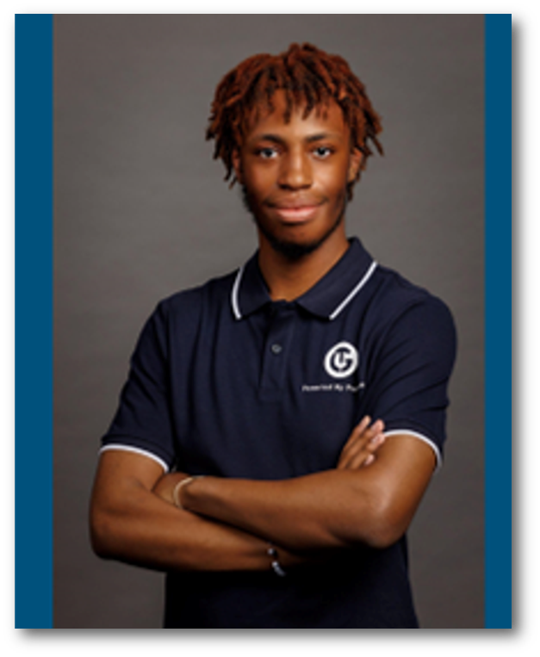
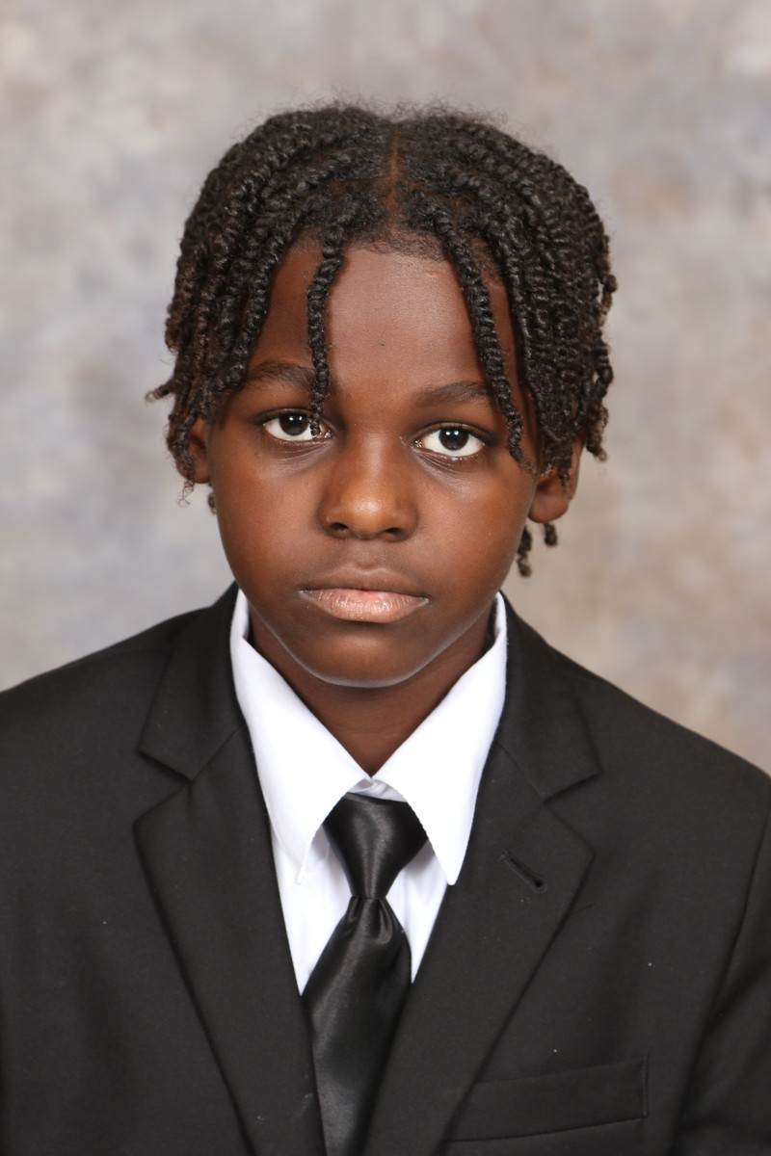
Go Team 2024-2025
At our first GO Team meeting, senior Marcus Daniels was
elected chair of BEST Academy's GO Team for the
2024-2025 school year, a historic first since the inception
of the GO Team Charter in Atlanta Public Schools.
Jahlil Muhammad, an 8th grader, is
selected as a student Representative.

